Slide 1
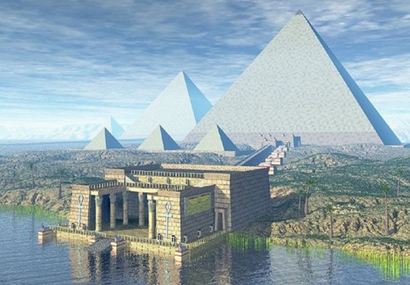
The Story of Ancient Egypt

Slide 2
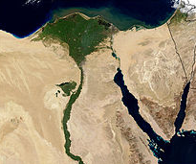
The Heart of Ancient Egypt:
The Nile River

Slide 3
CHUNKS
The Nile’s predictable floods and rich delta allowed for good farming.
The Nile delta, the upper cataracts, and the desert protected Egypt.
Papyrus plants were used for clothing, rope, and paper.
Notes:
100-104

Slide 4
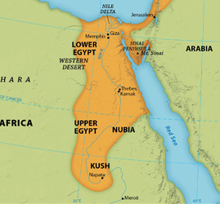
Upper and Lower
Egypt United by Narmer

Slide 5
CHUNKS
Lower Egypt included Memphis and the delta region. Upper Egypt included Thebes and the cataracts.
Narmar united these two in 3,000 B.C. and established the dynasties.
Egypt’s history is 30 dynasties divided into 3 kingdoms: Old, Middle, and New.
Notes:
106-107

Slide 6
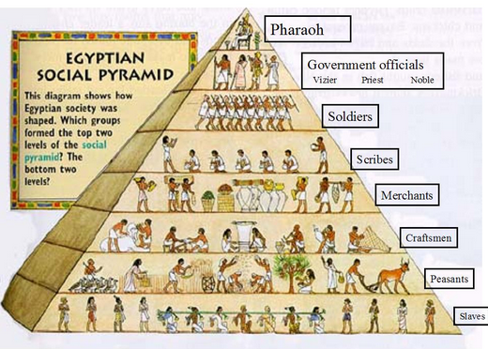
Egyptian Culture
One of the Greats

Slide 7
CHUNKS
Egypt’s social classes: Pharaoh, Priests and Govt, Soldiers, Scribes, Merchants, Craftsman, Farmers/Peasants, Slaves
Religion’s influence: Mummies, Medicine, and Pyramids
Cultural Achievement: Art, Architecture, Clothing, Dance, Writing, Science, etc.
Notes:
108-119

Slide 8
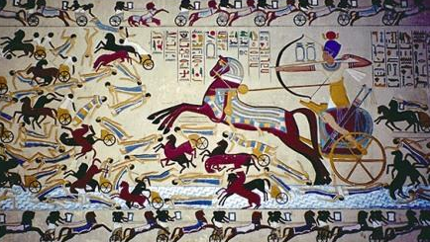
The Middle Kingdom:
Egypt’s Golden Age

Slide 9
CHUNKS
Conquests add to Egypt’s empire. Farm land is added. A canal to the Red Sea.
The capital is moved to Thebes (capital of upper Egypt). Arts flourish. Valley of the Kings.
Civil War weakens Egypt and the Hyksos invade Egypt and take over until Egyptians also master the chariot.
Notes:
120-121

Slide 10
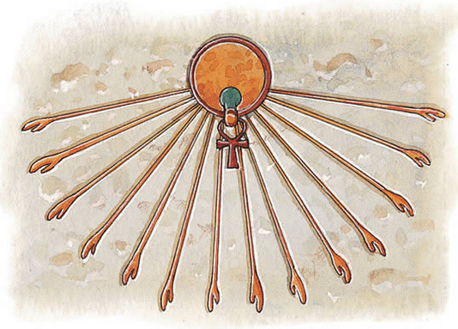
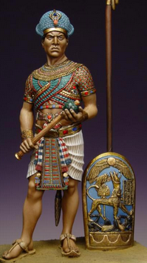
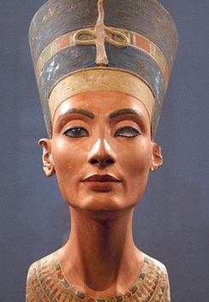
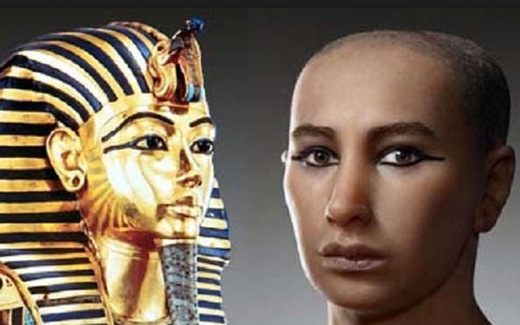
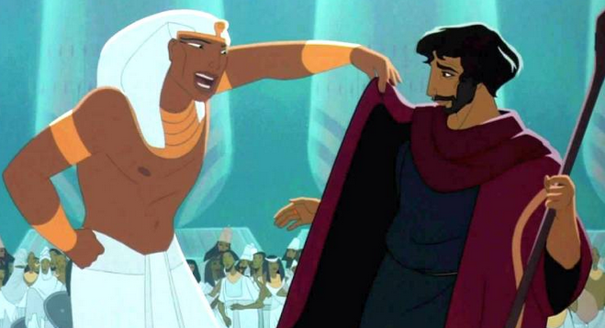
The New Kingdom:
Four Famous Pharaohs

Slide 11
CHUNKS
The height of Egyptian power. Egypt interacts with more of the world – cultural exchange.
Key Pharaohs: Hatshepsut, Thutmose, Amenhotep/Akhenaton, Ramses II
Ramses II and Moses ? (historians aren’t sure about this)
Notes:
125/125/126

Slide 12
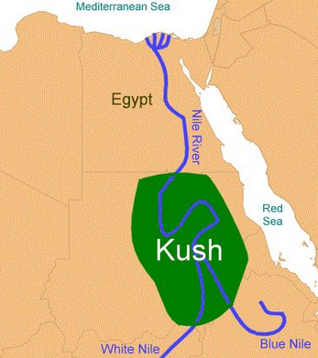
Egypt’s Decline and the Rise of Kush
Notes:
Lesson 4

Slide 13
CHUNKS
Egypt conquers Nubia/Kerma. Cultural exchange – religion, writing.
In 750 B.C. Kush invades Egypt and conquers it. Ruled a short time until Assyria invaded Egypt and defeated Kush. Kush learned iron.
3. Kush capital, Meroe, modeled on Egypt. Trade link between North/South Africa.
Notes:
128-133

